Slide 1

ClinicalBERT:
Modeling Clinical Notes and Predicting Hospital Readmission
Authors: Huang, Altosaar, Ranganath
Instructor:
DR. ABDUS SALAM

Slide 2
Group members
Name | ID
Nazim-E-Alam | 22-474047-1
Md. Mostafijur Rahman | 22-47161-1
M.M. Golam Hafiz | 22-48058-2
Md Shohanur Rahman | 22-46800-1
American International University-Bangladesh

Slide 3
The Problem
“How many of you have ever been admitted or know someone admitted to a hospital?”
Hospital readmissions cost $17.9B annually.
76% are avoidable.
American International University-Bangladesh

Slide 4
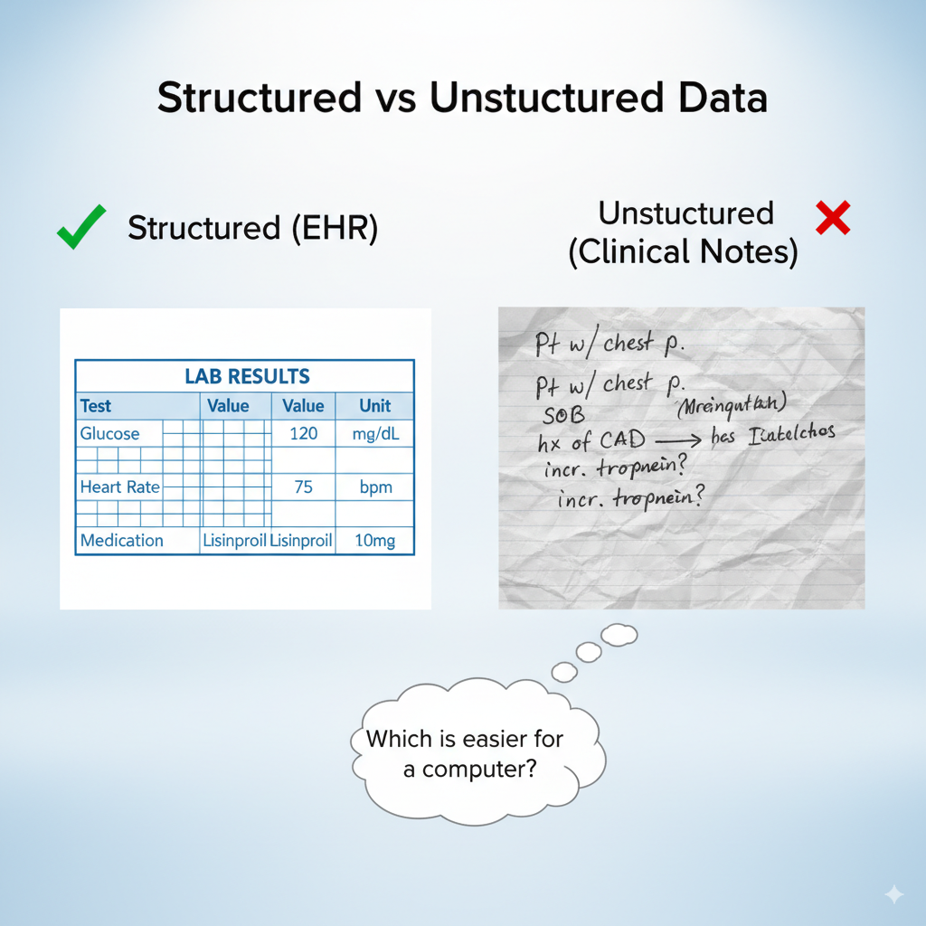
Structured vs. Unstructured Data
EHR = structured (lab results, medications) ✅
Clinical notes = unstructured (doctor’s free text) ❌
American International University-Bangladesh

Slide 5
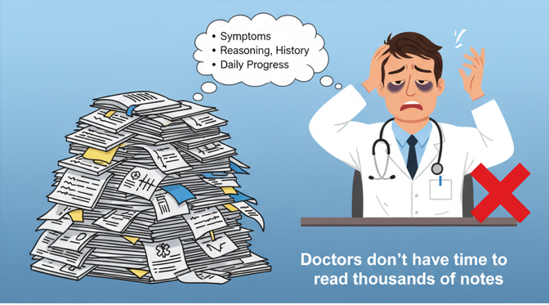
Why Notes Matter
Notes contain-.
reasoning
history
daily progress.
“Doctors don’t have time to
read thousands of notes”
American International University-Bangladesh

Slide 6
Why Notes Matter
Notes contain-.
reasoning
history
daily progress.
“Patient coughing for 5 days,
not eating well.”
Higher chance of readmission →
notes contain crucial clinical signals.
American International University-Bangladesh

Slide 7
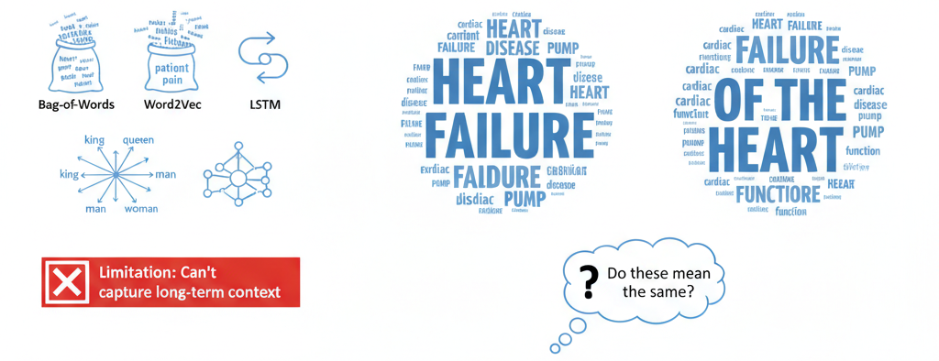
Enter NLP
American International University-Bangladesh

Slide 8
Enter NLP
Same meaning → BOW models fail, transformers capture semantics better.
American International University-Bangladesh

Slide 9
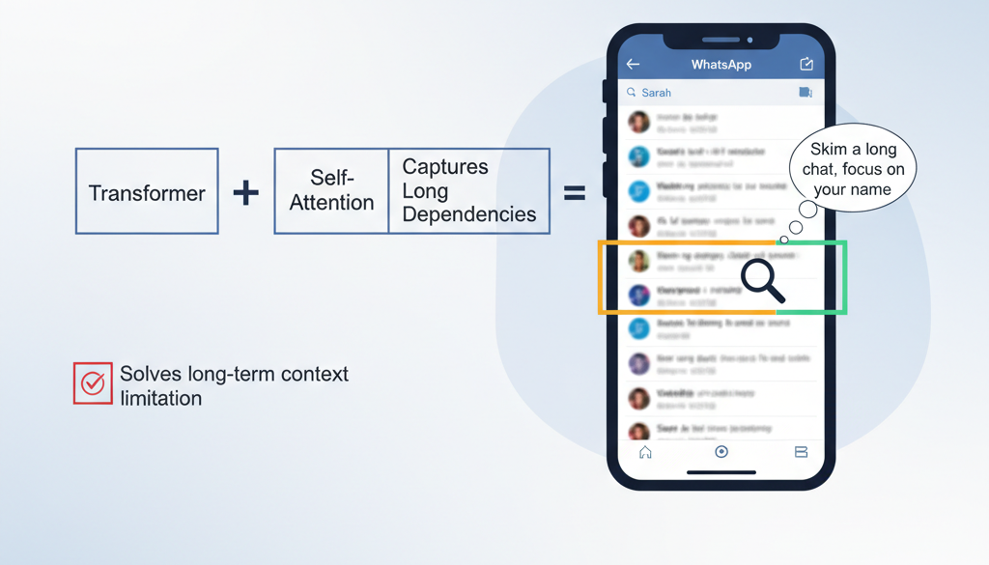
Why BERT?
Transformer
Self-Attention
Contextual Embedding
American International University-Bangladesh

Slide 10
Why BERT?
Transformer
Self-Attention
Contextual Embedding
“Attention is like skimming a
WhatsApp chat focusing only when
your name appears.”
American International University-Bangladesh

Slide 11
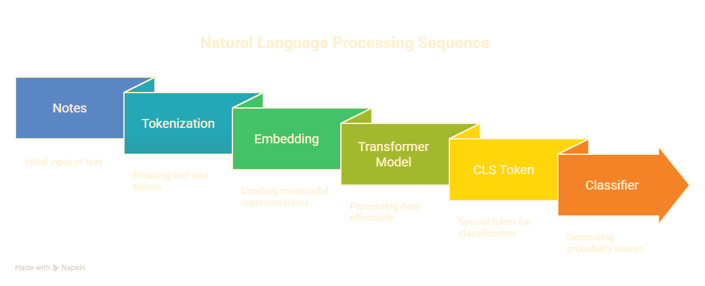
Clinical BERT Dataflow
BERT -> adapted to clinical notes
Specialized embeddings for clinical language (abbreviations, jargon).
Pretrained on MIMIC-III
-58k Admission
-2M notes
American International University-Bangladesh
Notes:
Clinical BERT is a special version of a language model called BERT, adapted to work with medical notes. Medical notes use a lot of short forms and special words that are hard for regular models to understand. This version is trained on a large set of real hospital records—thousands of patient admissions and millions of notes.
The process starts with these notes, which are broken down into smaller pieces called tokens. These tokens are then turned into numbers that computers can work with, called embeddings.
The model then looks at these numbers to find important patterns and meanings. A special token helps the model decide how to classify or categorize the text. Finally, the model gives predictions based on what it learned.
In short, Clinical BERT helps computers understand the unique language used by doctors and nurses, making it easier to analyze medical records."

Slide 12
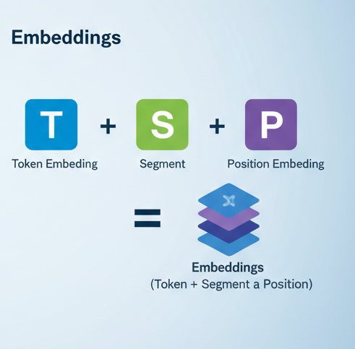
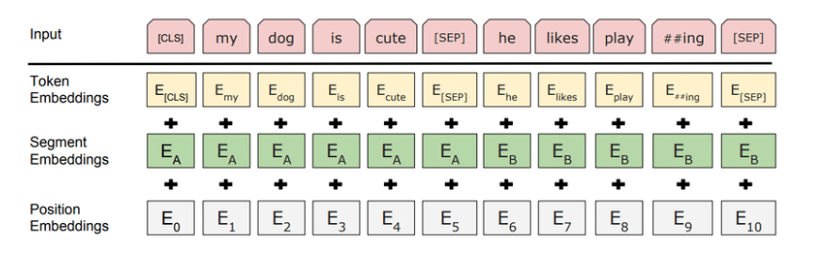
Embeddings
American International University-Bangladesh

Slide 13

Transformer
American International University-Bangladesh

Slide 14
Self Attention
Key–Value mechanism.
Captures relationships across
distant words.
Perfect for clinical notes with
long dependencies.
American International University-Bangladesh

Slide 15
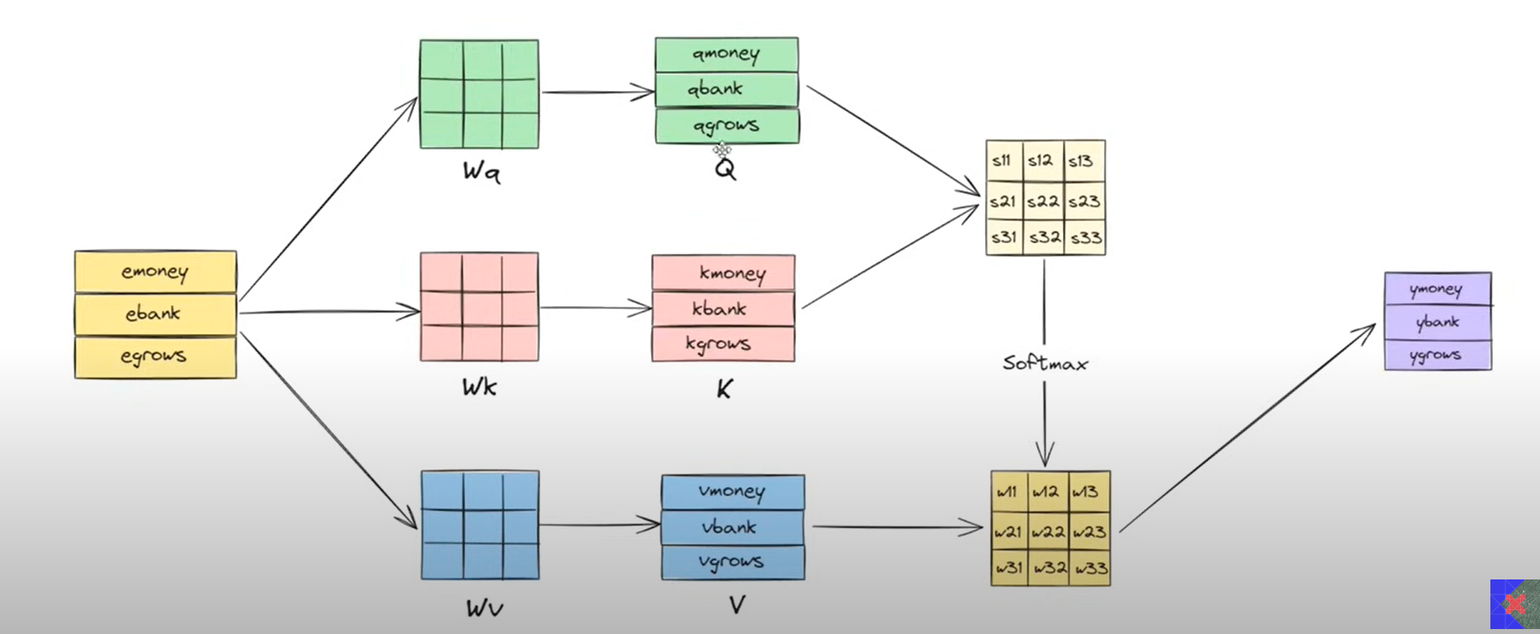
Self Attention
American International University-Bangladesh

Slide 16
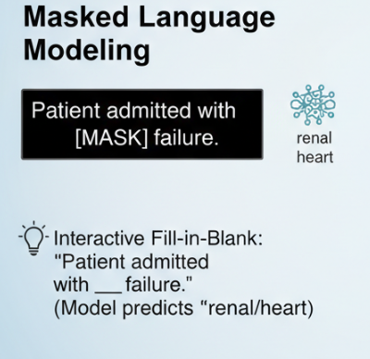
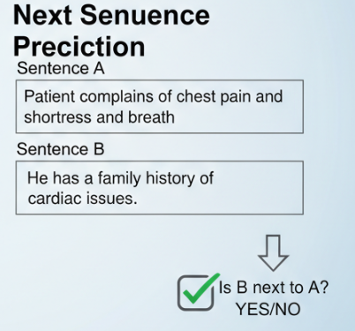
Pretraining Tasks
Masked Language Modeling (MLM): mask 15% tokens → predict.
Next Sentence Prediction (NSP): predict if two notes are consecutive.
Helps model learn medical language structure.
American International University-Bangladesh
Notes:
“ClinicalBERT uses the same pretraining tasks as BERT. The first model is Masked Language Modeling _ this model predicting missing words in sentences .for example ‘The patient was admitted with — failure then model predict renal or heart.
The second model is Next Sentence Prediction — this model predicting if one sentence follows another .for example sentence a and b are related or not then model are provide yes or no.

Slide 17
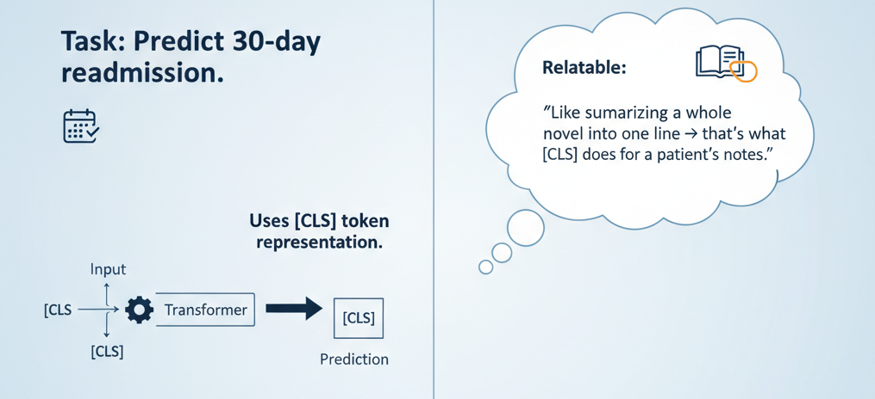
Fine-Tuning
Task: Predict if patient is readmitted
within 30 days.
Uses [CLS] representation →
logistic classifier.
Equation:
P(readmit=1 | h[CLS]) = σ(W h[
Executive summary of the whole record
Used for binary classification
American International University-Bangladesh
Notes:
“After pretraining, we train ClinicalBERT further to predict if a patient will be readmitted within 30 days. In ClinicalBERT, there is a special token called [CLS] that represents the whole input. We use the embedding of this [CLS] token and put it into a classifier, which gives the probability of readmission. This way, the model can update each patient’s risk score as new notes are added during their hospital stay.”

Slide 18
Hyperparameters
Category | Configuration
Model Architecture | Hidden size = 768 Transformer layers = 12 Attention heads = 12
Optimizer | Adam Learning Rate = 2e-5
Pretraining Setup | Sequence length = 128 → 512 (progressively increased) Batch size = 64 (short seq) / 8 (long seq)
Fine-Tuning Setup | Batch size = 56 Epochs = 3
American International University-Bangladesh
Notes:
“Hyperparameters are basically the settings we choose before training a model. They guide how the model learns but aren’t learned by the model itself. For ClinicalBERT, it follows the BERT-Base setup with 12 transformer layers, hidden size 768, and 12 attention heads. They used the Adam optimizer with a learning rate of 2e-5. Pretraining was done in two steps, first with sequence length 128, then extended to 512. For fine-tuning, the batch size was 56, trained over 3 epochs, with early stopping to prevent overfitting. These choices help keep a good balance between performance and GPU limits.”

Slide 19
Dataset (MIMIC-III)
ICU records, 2001–2012.
58,976 admissions, 38,597 patients, 2M+ notes.
After filtering: 34,560 patients, ~3k positive readmissions.
Preprocessing
Lowercasing, removing special characters.
Sentence segmentation with spaCy.
Merge short Segments(<20 words).
Example: “Pt. w/ CHF, SOB, hx CAD.” Answer: “Patient with Congestive Heart Failure, Shortness of Breath,
history of Coronary Artery Disease.”
American International University-Bangladesh
Notes:
“MIMIC-III is a large ICU dataset collected from 2001 to 2012 at Beth Israel Hospital. It contains almost 59,000 admissions, over 38,000 patients, and more than 2 million clinical notes. After filtering out newborns and patients who died in hospital, the final set had around 34,500 patients, including about 3,000 with readmissions. “The preprocessing pipeline cleaned and standardized notes. This included lowercasing, removing special characters, and handling abbreviations.

Slide 20
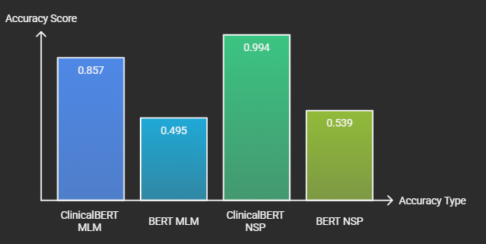
Results: Language Modeling
American International University-Bangladesh
Notes:
we tested two pretraining tasks: Masked Language Modeling and Next Sentence Prediction.
What we found is that ClinicalBERT consistently outperforms vanilla BERT in both tasks.
For MLM, ClinicalBERT was much better at filling in masked words And for NSP, it also showed stronger performance in identifying the correct sentence order and capturing the right clinical context.

Slide 21
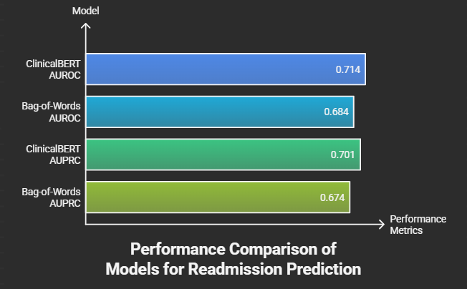
Results: Readmission (Discharge Summaries)
American International University-Bangladesh

Slide 22
Results: Readmission (Discharge Summaries)
Even with only 48–72h of notes, ClinicalBERT predicts better.AUROC ~0.67, beats BOW, BiLSTM, BERT.Enables earlier intervention.
Scenario: “If you only had 2 days of notes, could you predict?”
Answer: Yes → ClinicalBERT is more robust than baselines.
American International University-Bangladesh

Slide 23
Clinical Implications
Early risk scoring can reduce avoidable readmissions.
Adaptable to: mortality risk, disease prediction, length of stay.
Deployment challenges: data privacy, adaptation to hospitals.
“Where would you deploy first: ICU, General Ward, Outpatient?”
ICU (high risk, real-time decisions).
American International University-Bangladesh

Slide 24
Limitation
Domain Generalization → Trained only on MIMIC-III ICU notes (single hospital, Boston); may not generalize to other hospitals or clinical settings.
Sequence Length Constraint → BERT max = 512 tokens; clinical notes are much longer, forcing splitting and possible loss of context.
Compute & Resources → Requires GPUs and large compute for pretraining/fine-tuning, limiting smaller hospitals.
Privacy Concerns → Patient data is highly sensitive (HIPAA/GDPR); data sharing for retraining is difficult.
Interpretability → Attention helps but predictions still feel like a “black box” to clinicians.
Adoption Barrier → Clinicians may not fully trust AI predictions; alarm fatigue can reduce usefulness.
American International University-Bangladesh

Slide 25
Conclusion
ClinicalBERT adapts BERT to clinical notes by pretraining on MIMIC-III, enabling better understanding of medical jargon and context.
It significantly outperforms baseline models in predicting 30-day hospital readmissions, even from early-stage notes. While powerful, its limitations include data privacy, sequence length constraints, and challenges in real-world clinical adoption.
American International University-Bangladesh

